Slide 1
Introduction to H-Bridge

Slide 2
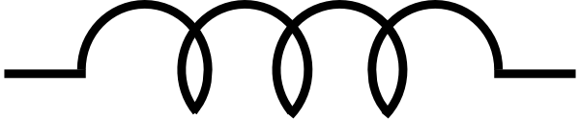
How does a motor turn?
5 V
gnd
i
gnd
5 V
i
If you want to change the direction of the rotation, change the direction of current flow

Slide 3
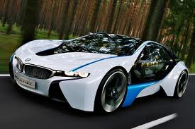
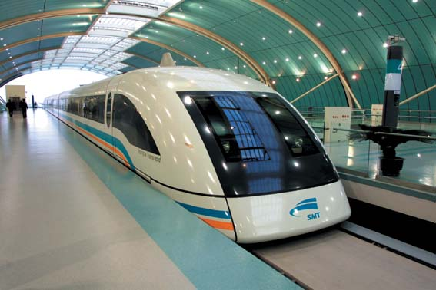

How much current does a motor need?
Your nano board works @ 5 V, 0.5 Ams AT MOST
Depending on the application, motors need huge amount of voltage and current

Slide 4
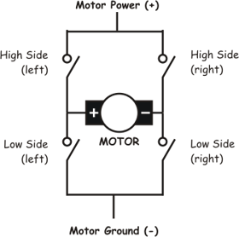
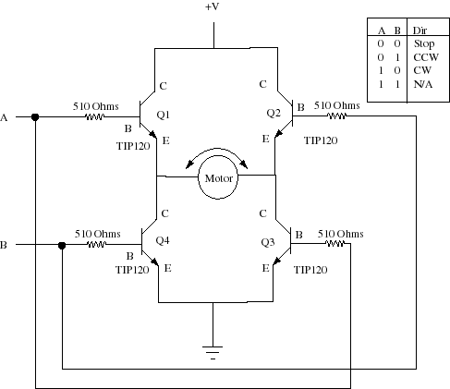
H-Bridge
Drive signal A & B from your Nano board
  Transistor is an electronic switch
  What happens if A = 1, B = 1 and V = 25 K?

Slide 5
H-Bridge
A & B must be driven by square wave pulses as shown above
  Have you seen such square wave before?

Slide 6
!
H-Bridge Inverter Basics – Creating AC from DC
Single-phase H-bridge (voltage source) inverter topology:
Switching rules
•
Either A+ or A
–
is closed,
Vdc
but never at th
e same time *
•
Either B+ or B
–
is closed,
but never at the same time *
*same time closing would cause a short circuit from Vdc to ground
(shoot-through)
*To avoid shoot-through when using real switches (i.e. there are turn-on and turn-off delays) a dead-time or blanking time is implemented
A+
B+
Va
Load
Vb
A
–
B
–
Corresponding values of Va and Vb
•
A+ closed, Va = Vdc
•
A
–
closed, Va = 0
•
B+ closed, Vb = Vdc
•
B
–
closed, Vb = 0

Slide 7
H BRIDGE INVERTER
Corresponding values of Vab
•
A+ closed
and B
–
closed, Vab = Vdc
Vdc
•
A+ closed and B+ closed, Vab = 0
•
B+ closed and A
–
closed, Vab =
–
Vdc
•
B
–
closed and A
–
closed, Vab = 0
A+
B+
+ Vdc −
•
The free wheeling diodes permit current
to flow even if al
l switches are open
Va
Load
Vb
•
These diodes also permit lagging
currents to flow in inductive loads
A
–
B
–

Slide 8
H BRIDGE INVERTER
Corresponding values of Vab
•
A+ closed
and B
–
closed, Vab = Vdc
Vdc
•
A+ closed and B+ closed, Vab = 0
•
B+ closed and A
–
closed, Vab =
–
Vdc
•
B
–
closed and A
–
closed, Vab = 0
A+
B+
+ 0 −
•
The free wheeling diodes permit current
to flow even if al
l switches are open
Va
Load
Vb
•
These diodes also permit lagging
currents to flow in inductive loads
A
–
B
–

Slide 9
H BRIDGE INVERTER
Corresponding values of Vab
•
A+ closed
and B
–
closed, Vab = Vdc
Vdc
•
A+ closed and B+ closed, Vab = 0
•
B+ closed and A
–
closed, Vab =
–
Vdc
•
B
–
closed and A
–
closed, Vab = 0
A+
B+
− Vdc +
•
The free wheeling diodes permit current
to flow even if al
l switches are open
Va
Load
Vb
•
These diodes also permit lagging
currents to flow in inductive loads
A
–
B
–

Slide 10
H BRIDGE INVERTER
Corresponding values of Vab
•
A+ closed
and B
–
closed, Vab = Vdc
Vdc
•
A+ closed and B+ closed, Vab = 0
•
B+ closed and A
–
closed, Vab =
–
Vdc
•
B
–
closed and A
–
closed, Vab = 0
A+
B+
+ 0 −
•
The free wheeling diodes permit current
to flow even if al
l switches are open
Va
Load
Vb
•
These diodes also permit lagging
currents to flow in inductive loads
A
–
B
–

Slide 11
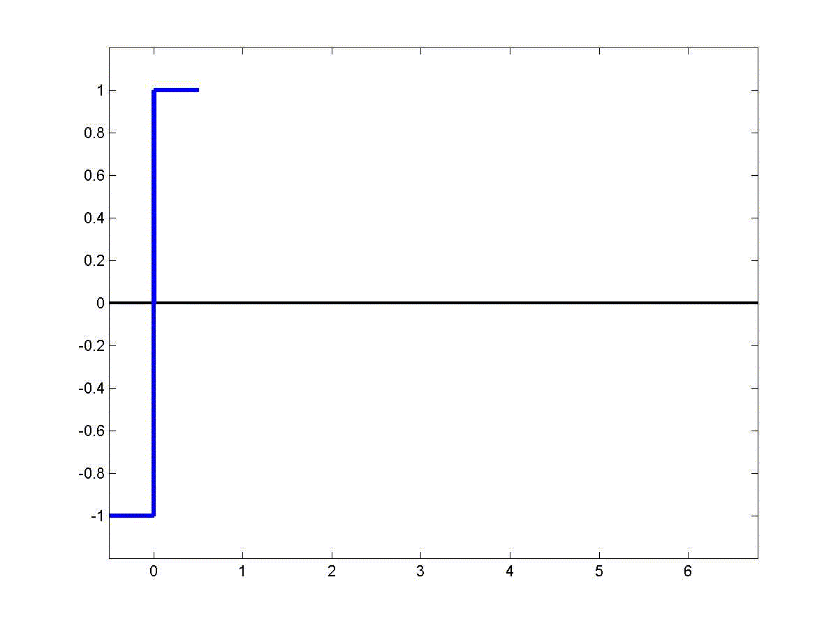
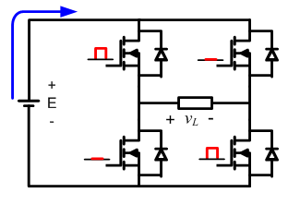
H-Bridge Inverter
Square wave modulation:

Slide 12
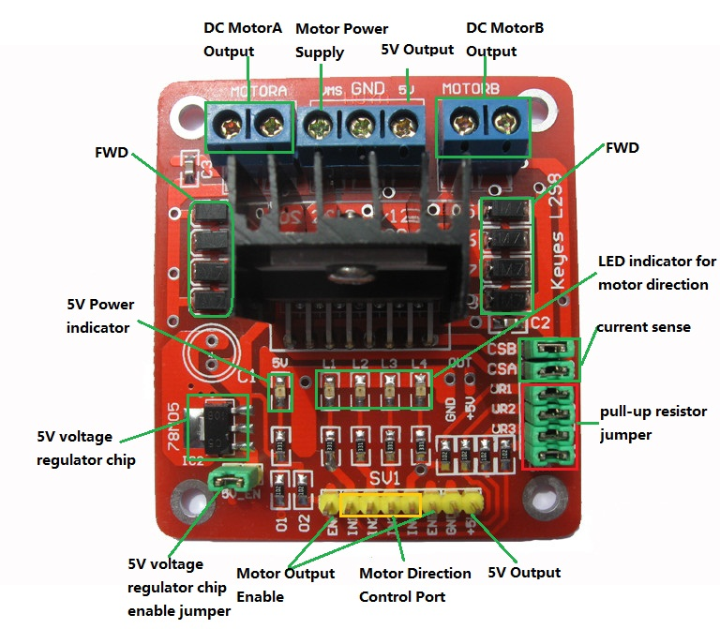
Component: H-bridge Circuit
Circuit

Slide 13
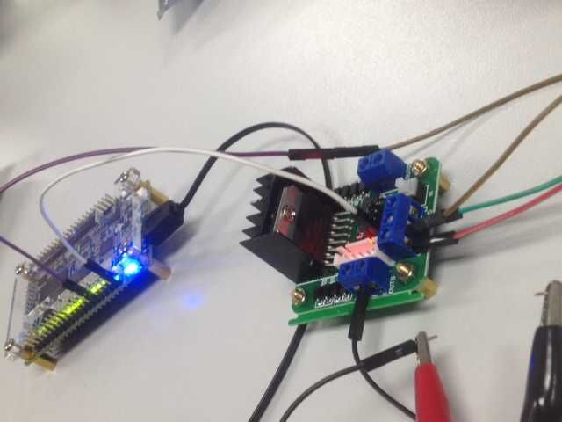
Connection
Power input
PWM
output

Slide 14
Tasks
Drive your car
Forward, backward, turn around.
Change the moving speed

Slide 15
Questions

